Slide 1
HACKATHON
FIND THE INTEREST AMOUNT FOR CURRENT YEAR
BINARY LORDS

Slide 2
TEAM : BINARY LORDS
John Cigi (TEAM LEAD) [875217]
Mohamood Hassan V P [875248]
Mohammed Kutti Nihal [875162]
Janakikutty K [875250]
Pravya P [875249]
Sumayya Sana [875245]

Slide 3
PROBLEM STATEMENT
Find the EMI for Car with,
Price of 15 Lakhs
Interest rate of 9.5%
Loan Tenure - 1 year.
Display the interest amount & principal amount for one month

Slide 4
PROBLEM STATEMENT
From Menu, pick Home Loan EMI Calculator.
Fill relevant details and extract all the data from year on year table.
Store the data in excel.

Slide 5
PROBLEM STATEMENT
From Menu, pick Loan Calculator.
Under EMI calculator, do all UI check for text box & scales.
Change the Loan tenure for year & month, check the change in scale.
Re-use the same validation for Loan Amount Calculator & Loan Tenure Calculator

Slide 6
WEBSITE USED
EMI CALCULATOR - https://emicalculator.net
Web application that is used to calculate EMI for home loan, car loan, personal loan, education loan or any other fully amortising loan.

Slide 7
SOFTWARES/TOOLS USED
SELENIUM - Portable Framework for testing Web Application.
JAVA - Programming Language.
Eclipse - Integrated Development Environment.
TestNG - Open Source Testing Framework.
Maven - Software and project Management Tool.
POM - Object Repository Design Pattern.
Apache POI - JAVA library for reading and writing in Microsoft format.
Extent HTML Report - Customizable HTML report.
Git - Open source distributed version control system.
Jenkins - Open source automation server.
Selenium Grid - Distributed test execution.

Slide 8
WORK DONE
The code is written in JAVA language and automated using Selenium.
Page Object Model (POM) is used to reduce code duplication.
TestNG is used to Segregate Smoke and Regression tests.
Data obtained is stored in Excel sheet using Apache POI.
Html report is generated using Extent report.

Slide 9
CODE FRAMEWORK
Three classes for three modules under one package “mainFunctionalities”.
Four classes for each test scenarios under “testScenarios” package with total 15 test cases.
Code flexibility is kept so that changes can be made and test cases can be changed easily.
“DriverSetup” is a class for the functions that are common to the module classes in mainFunctionalities package.
Two separate suites, Firefox_Suite and Chrome_Suite for Firefox and Chrome browser testing, called from Hackathon_DataDriver suite(testng.xml) and each suite consist of Smoke and Regression testing.
Input is taken from “Input.xlsx” ,“config.properties” file.
Output is created in “firefoxOutput.xlsx” and “chromeOutput.xlsx” in two different sheets with individual names.
Code was pushed and committed to GitHub and Jenkins was implemented.

Slide 10
CONSOLE OUTPUT

Slide 11
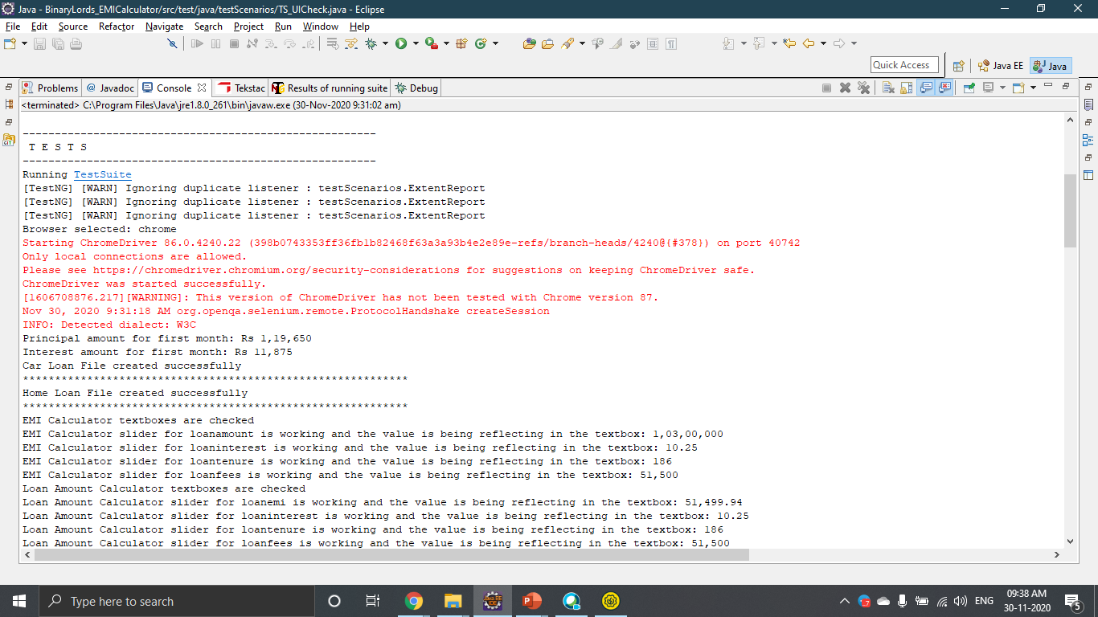

Slide 12
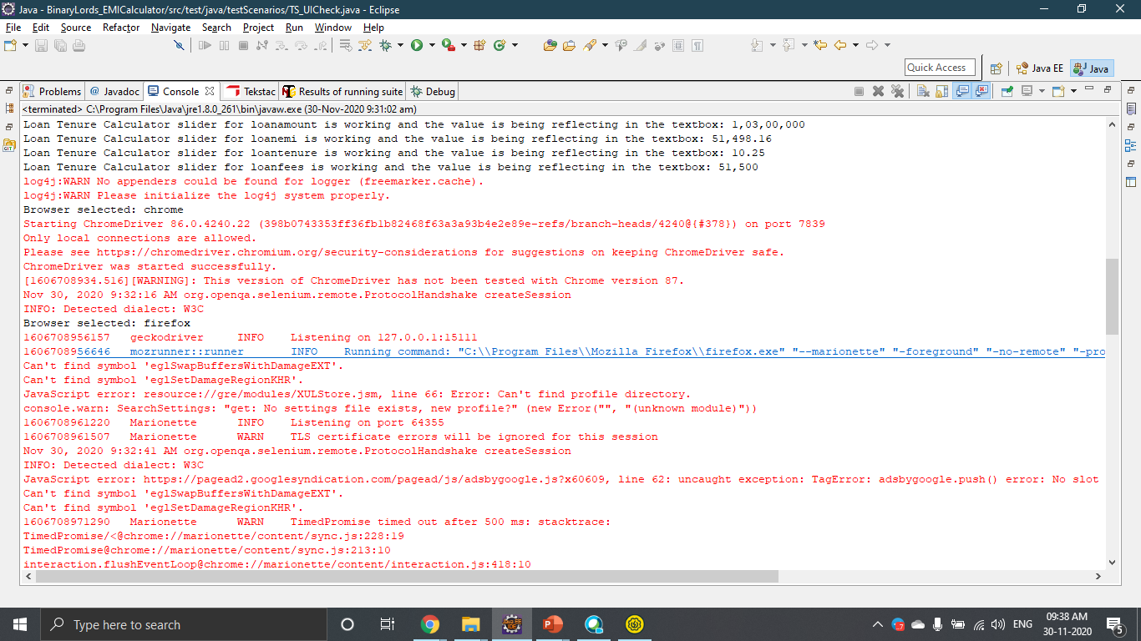

Slide 13
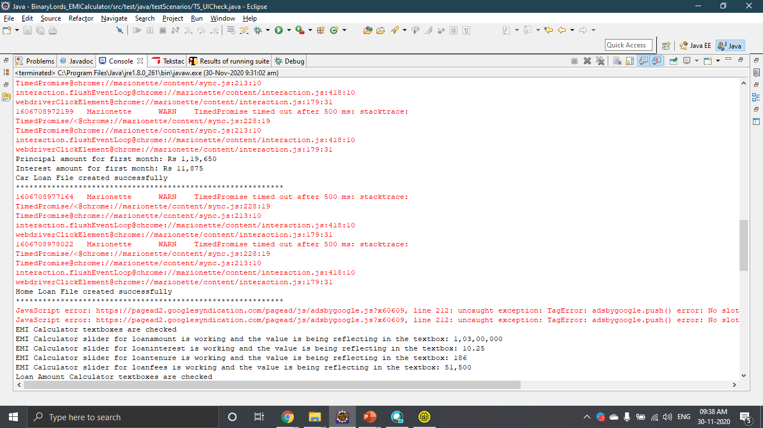

Slide 14
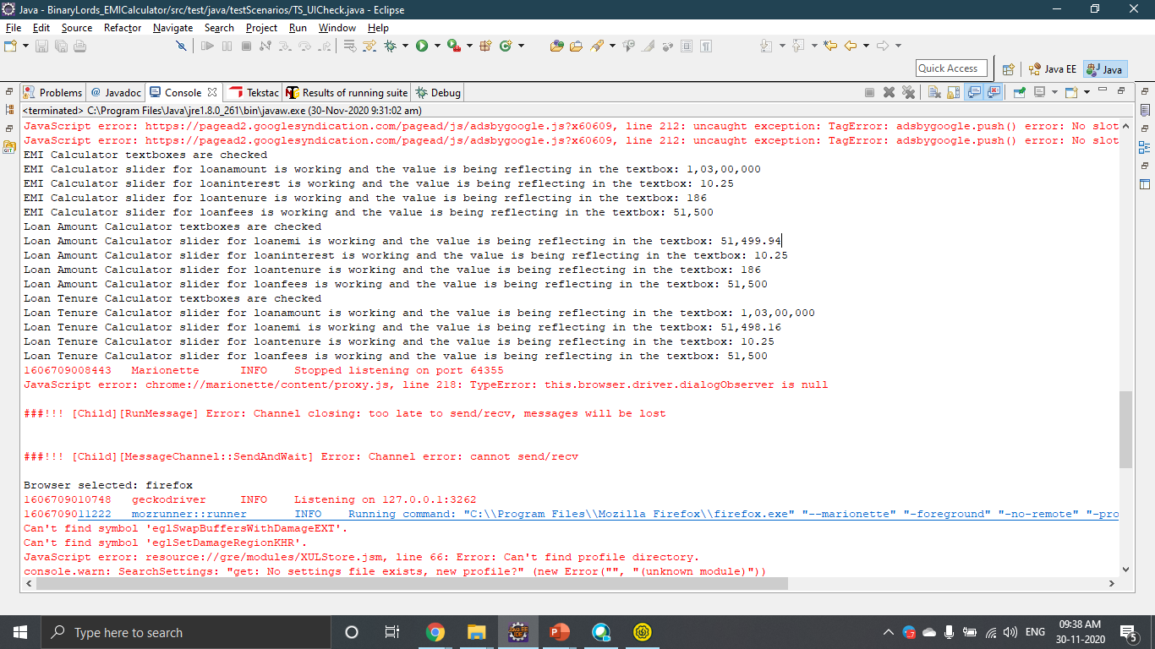

Slide 15
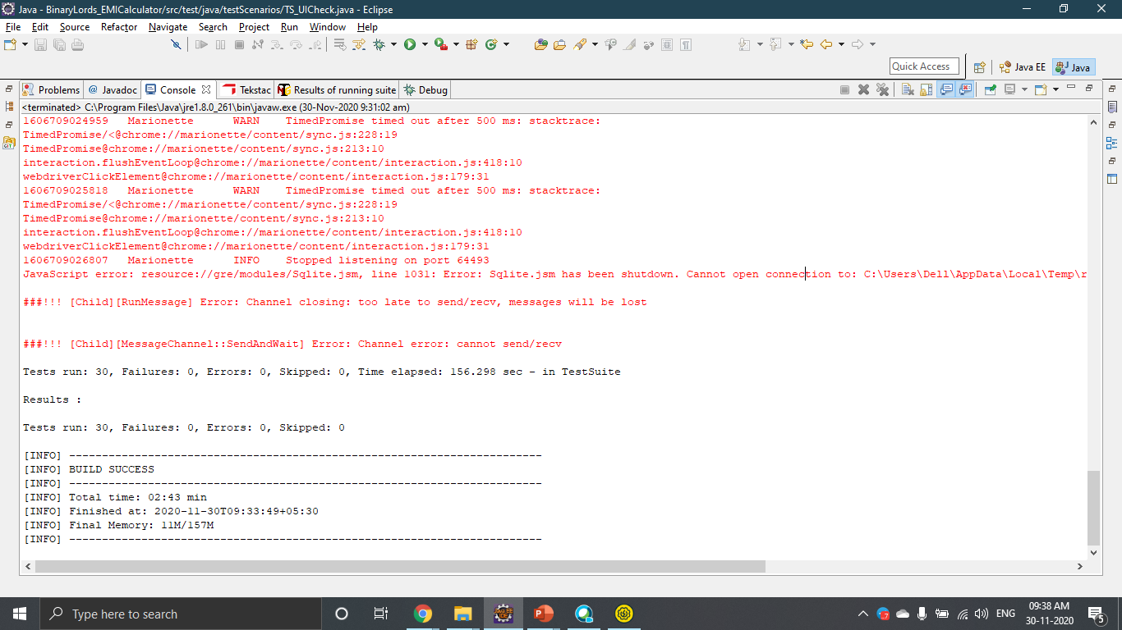

Slide 16
THANK YOU

